Slide 1
IC₅₀=7.922 μg/mL
(μg/mL)
Supplement Fig. 1. Free radical scavenging activity of GEGR. DPPH radical scavenging activity was measured in a reaction mixture containing 0.1 mM DPPH and different concentrations of GEGR (1 - 2,000 μg/mL). Inhibitory activity was measured in duplicates. The data represents the means ± SD.

Slide 2
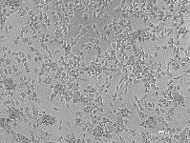
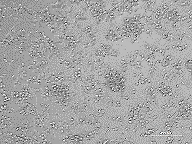
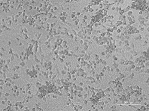
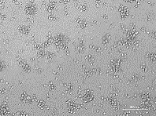
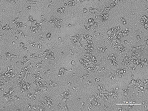
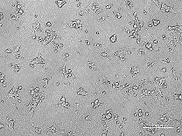
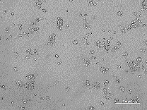
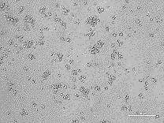
GEGR
GEGR
Vehicle 25 50 100
Vehicle 25 50 100
HCC-2108
NCI-H1435
*
*
*
*
*
*
Relative level of cell viability
Relative level of cell viability
Vehicle 25 50 100
Vehicle 25 50 100
GEGR
GEGR
Supplement Fig. 2. Cell viability assay of GEGR treated (A) HCC-2108 and (B) NCI-H1435 cells. After incubation of cells with 25, 50 and 100 ug/mL (HCC-2108 cells), or 100, 200 and 400 μg/mL (NCI-H1435 cells) of GEGR for 24 h, cell morphologies were observed under a microscope at 400× magnification. Cell viability was determined by the MTT assay. Two to three wells per group were used in the MTT assay, and optical density was measured in duplicates. The data represents the means ± SD. *, p<0.05 relative to the Vehicle treated group.

Slide 3
Body weight (g)
Liver weight (g)
Lung weight (g)
No Cis 250 500 1000
No Cis 250 500 1000
No Cis 250 500 1000
GEGR
GEGR
GEGR
Thymus weight (g)
Spleen weight (g)
*
No Cis 250 500 1000
No Cis 250 500 1000
GEGR
GEGR
Supplement Fig. 3. Alternation on the body and organ weight in C57BL/6NKorl mice with LLC1-bearing tumor after treatment of GEGR. Changes in body weight, liver weight, lung weight, thymus weight and spleen weight. The body and organ weight were measured using chemical balance throughout the experimental period. Data are reported as the means ± SD. *, p<0.05 compared to the Vehicle treated group. #, p<0.05 compared to the Cis treated group.

